Slide 1
L.U 4: MANAGE EMBEDDED SYSTEM

Slide 2
Managing an embedded system refers to the activities and processes involved in overseeing and controlling the operation, maintenance, and functionality of an embedded system.
An embedded system is a specialized computing system dedicated to performing specific functions within a larger system or product.
These systems are embedded into devices such as appliances, automotive systems, industrial machines, medical devices, and more.

Slide 3
Here are some key aspects of managing embedded systems:
Design and Development: This involves the initial planning, design, and development of the embedded system. Managers need to ensure that the system meets the specified requirements, is cost-effective, and can be efficiently manufactured.
Integration: Embedded systems often need to integrate with other components and systems. Managing this integration process ensures that all parts work together seamlessly to achieve the desired functionality.
Testing and Validation: Full testing and validation processes are essential to ensure the reliability, performance, and safety of the embedded system. Managers oversee the testing procedures and address any issues identified during this phase.

Slide 4
Conts,
Maintenance and Upgrades: Once deployed, embedded systems require ongoing maintenance to ensure continued functionality. Managers are responsible for implementing maintenance plans and overseeing any upgrades or updates to the system.
Power Management: Many embedded systems operate on limited power resources, especially in battery-powered devices. Efficient power management is crucial, and managers need to consider strategies for optimizing power consumption without compromising performance.
Security: As with any computing system, embedded systems need to be secure to prevent unauthorized access and protect sensitive data. Managing the security of an embedded system involves implementing robust security measures and staying informed about potential vulnerabilities.

Slide 5
Conts,
Lifecycle Management: Embedded systems have a lifecycle that includes design, development, deployment, eventually and retirement. Managers need to plan for the entire lifecycle, including end-of-life considerations such as product discontinuation or replacement.
Regulatory Compliance: Depending on the industry and application, embedded systems may need to comply with specific regulations and standards. Managers must ensure that the embedded system meets these requirements.
Communication Protocols: In systems where embedded devices communicate with each other or with external systems, the choice and management of communication protocols are crucial. Managers need to ensure compatibility and reliability in data exchange.

Slide 6
4.1. Firmware deployment
Firmware deployment is a critical aspect of managing an embedded system, and it involves the process of loading the firmware into the microcontroller or embedded processor that controls the embedded system's operation.

Slide 7
Here are two key considerations in firmware deployment:
1.Load Firmware into the Controller
"Load Firmware into the Controller" refers to the process of transferring or installing firmware onto a microcontroller or a similar embedded system.

Slide 8
How Load Firmware into the Controller?
Prepare the Firmware
Connect the Controller
Select the Programming Method
Use a Programmer/Debugger
Configure Programming Software
Initiate the Programming Process
Verify and Test
Deploy the Controller

Slide 9
2.Verifying the Integrity of the Deployed Firmware
Verifying the integrity of deployed firmware refers to the process of ensuring that the firmware (software that is embedded in hardware) running on a device or system has not been tampered with or corrupted. This is a crucial aspect of cybersecurity and system reliability, especially in scenarios where the firmware is critical for the proper functioning and security of a device

Slide 10
Here are key components of verifying the integrity of deployed firmware
Checksums or Hashes: One common method is to generate a cryptographic hash or checksum of the firmware image before deployment. This hash is a unique identifier derived from the content of the firmware file. After deployment, the system can recalculate the hash and compare it with the originally generated value. If the two values match, it indicates that the firmware has not been altered.
Digital Signatures: Another approach involves digitally signing the firmware with a private key during the development or manufacturing process. The corresponding public key is embedded in the device. During firmware verification, the device uses the public key to verify the signature. If the signature is valid, it means the firmware has not been tampered with.

Slide 11
3.Secure Boot: This is a mechanism where the device checks the digital signature of the firmware before allowing it to execute during the boot process. If the signature is valid, the firmware is considered trusted, and the system proceeds with the boot process. If the signature is invalid or missing, the system may halt or take predefined actions to prevent the execution of compromised firmware.
4.Runtime Integrity Checking: Continuous monitoring of the firmware during runtime to detect any unauthorized modifications. This involves periodic checks on critical parts of the firmware to ensure they match the expected values.
5.Hardware-based Security: Some systems incorporate hardware-based security features, such as Trusted Platform Modules (TPMs) or Hardware Security Modules (HSMs), to enhance the security of the firmware. These modules can store keys securely and perform cryptographic operations, contributing to the overall integrity of the system.

Slide 12
4.2.Testing embedded system (Practical work on the study site)
Selection Test Cases
Functional Testing
Performance Testing
Compatibility Testing
Usability Testing
Environmental Testing

Slide 13
4.3.Embedded system deployment and monitoring
Embedded system deployment and monitoring refer to the processes involved in deploying and overseeing the operation of embedded systems.
Here's an overview of embedded system deployment and monitoring:
Deployment:
Installation: This involves physically or virtually integrating the embedded system into the target environment. It may include loading software, connecting hardware components, and configuring the system for its intended purpose.
Configuration: Setting up parameters and initial settings to ensure the embedded system operates as intended. This could involve programming the system to adapt to specific environmental conditions or user requirements.
Testing: Rigorous testing is crucial to verify that the embedded system functions correctly in its intended environment.

Slide 14
2.Monitoring:Include,
Performance Monitoring
Fault Detection and Diagnostics
Security Monitoring
Remote Monitoring

Slide 15
3.Maintenance and Updates: Including;
Software Updates
Hardware Maintenance

Slide 16
4.Data Logging:including,
Collecting and Analyzing Data

Slide 17
Remote/online monitoring
Remote or online monitoring refers to the ability to observe and manage systems, devices, or processes from a distant location using various technologies. This is crucial for efficient management, troubleshooting, and maintenance, especially in fields such as IT, healthcare, manufacturing, and infrastructure.
Lets talk about:
Establishing Connectivity
Create API
Create a monitoring dashboard

Slide 18
1. Establishing Connectivity:
a. Networking:
Secure Connection: Establishing a secure connection is paramount to prevent unauthorized access. VPNs (Virtual Private Networks) or secure protocols like SSH (Secure Shell) are commonly used.
Reliability: Ensure a reliable network connection, as interruptions could lead to data loss or inaccurate monitoring.
b. Protocols:
Internet of Things (IoT) Protocols: MQTT, CoAP, and HTTP are common protocols for IoT devices, ensuring efficient communication between devices and monitoring systems.
Standard Protocols: Use standard protocols like SNMP (Simple Network Management Protocol) for network devices or OPC (OLE for Process Control) for industrial processes.

Slide 19
2. Create API:
a. RESTful APIs:
Design and Documentation: Develop a RESTful API for communication between monitored devices and the monitoring system. Proper documentation is crucial for developers to integrate their systems seamlessly.
Authentication: Implement secure authentication mechanisms, such as API keys or OAuth, to control access to the API.
b. Integration:
Open APIs: Create open APIs that encourage third-party integration, enabling interoperability with a wide range of systems and tools.
Data Formats: Support multiple data formats (JSON, XML) for flexibility in data exchange.

Slide 20
3. Create a Monitoring Dashboard:
a. User Interface (UI):
Intuitive Design: Design a user-friendly interface for the monitoring dashboard, making it easy for users to navigate and understand the data.
Customization: Allow users to customize dashboards based on their specific monitoring needs.
b. Real-time Visualization:
Graphs and Charts: Use visual elements like graphs and charts to represent real-time data trends, helping users quickly identify issues or anomalies.
Alerts: Implement alerting mechanisms to notify users of critical events or deviations from normal operation.

Slide 21
c. Historical Data and Reporting:
Data Storage: Store historical data for trend analysis and compliance reporting. Utilize databases suitable for time-series data, such as InfluxDB or Prometheus.
Reporting Tools: Integrate reporting tools to generate custom reports based on historical performance data.
d. Scalability and Performance:
Scalable Architecture: Design the monitoring system with scalability in mind to handle increasing numbers of monitored devices or data points.
Optimization: Optimize the system for performance, ensuring minimal latency in data retrieval and real-time updates.

Slide 22
GROUP WORK
Discuss in deep about the below point found in LO4 Which is Manage Embedded System
1. Firmware deployment
✓ Load firmware into the controller
✓ Verifying the integrity of the deployed firmware.
2.Testing embedded system
✓ Selection Test Cases
Functional Testing
Performance Testing
Compatibility Testing
Usability Testing
Environmental Testing
Test Documentation

Slide 23
3.Embedded system deployment and monitoring:
✓ Deployment of embedded system
✓ Physical/offline monitoring
✓ Remote/online monitoring
Establishing Connectivity
Create API
Create a monitoring dashboard

Slide 24
Practical work
Deploying IoT device Using MQTT broker. MQTT publisher MQTT client to Create a Monitoring Dashboard that will real time monitor DHT11 sensor value in such environment whereby creating visualization dashboard and chart.

Slide 25
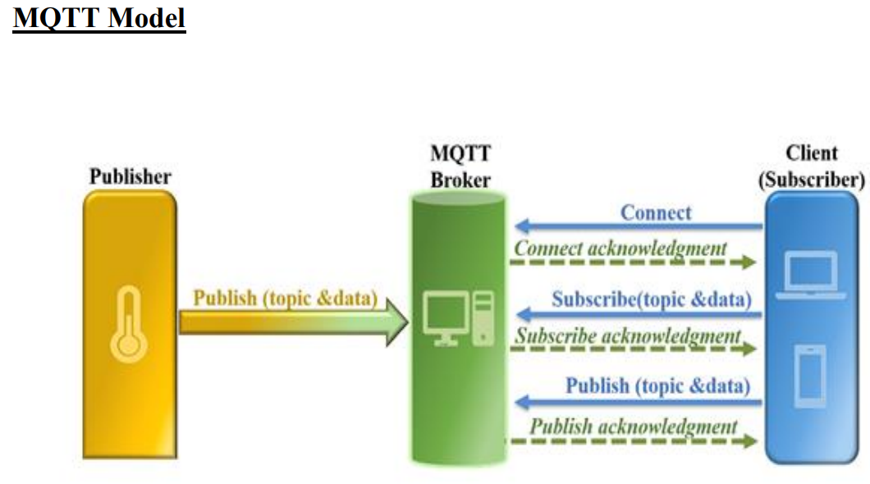
MQTTIt is an IoT interaction protocol based on the Publish/Subscribe mode.

Slide 26
MQTT broker: An MQTT broker is a server or middleware that acts as a central point for handling communication between MQTT clients. It receives messages from MQTT publishers and routes them to the correct MQTT subscribers.
MQTT publisher: An MQTT publisher is a client application that sends messages to an MQTT broker.
MQTT subscriber: An MQTT subscriber is a client application that receives messages from an MQTT broker.

Slide 27
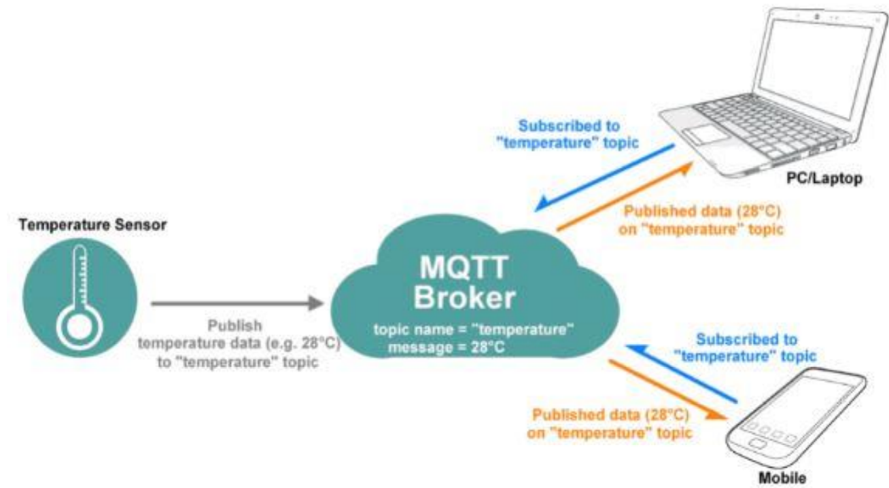
In our work we are going to use NodeMCU MQTT Client with Arduino IDE

Slide 28
Install required libraries
First, refer to Getting Started with NodeMCU using Arduino IDE if you are not installed NodeMCU board packages in Arduino IDE.
Follow this link below:
Getting Started with NodeMCU using Arduino IDE | NodeMCU (electronicwings.com)

Slide 29
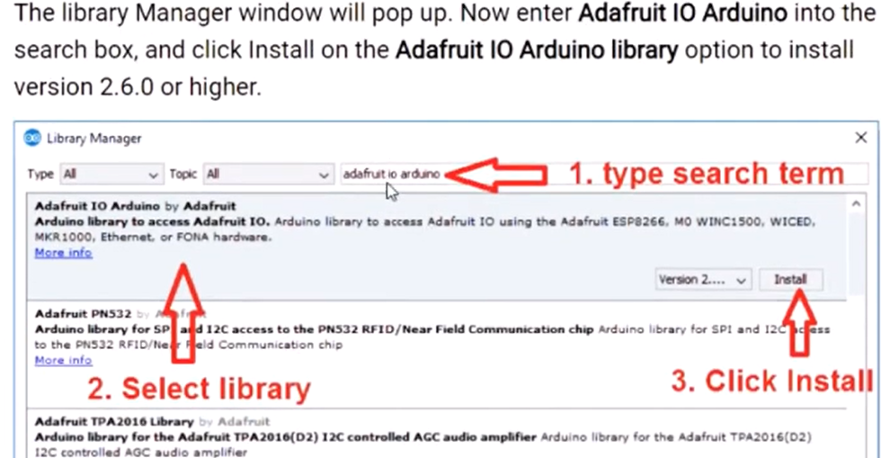
Secondary, We will need to install the Adafruit IO, Adafruit MQTT, and ArduinoHttpClient libraries using the Arduino Library Manager.

Slide 30
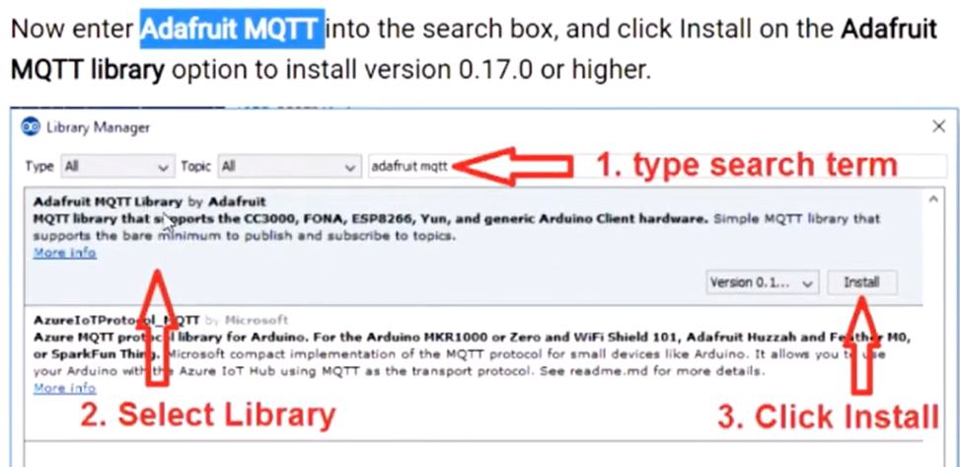

Slide 31
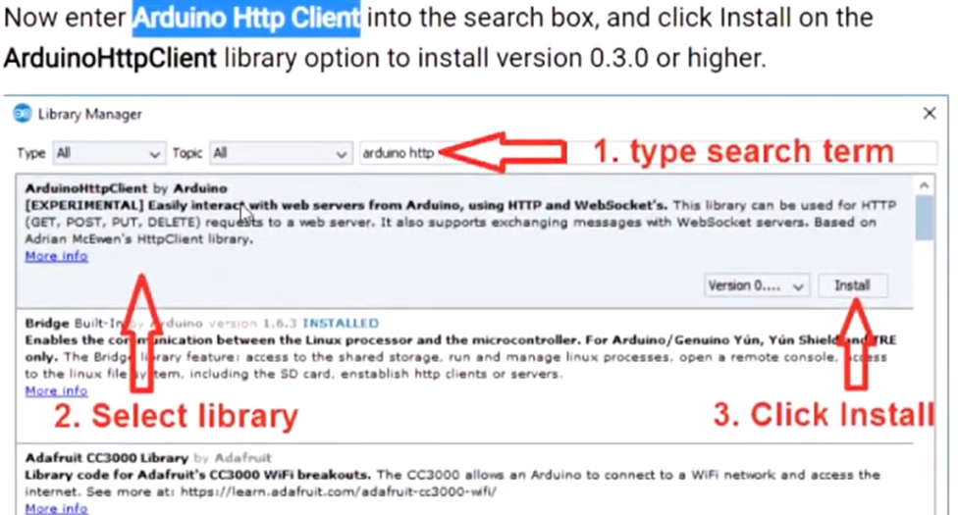

Slide 32
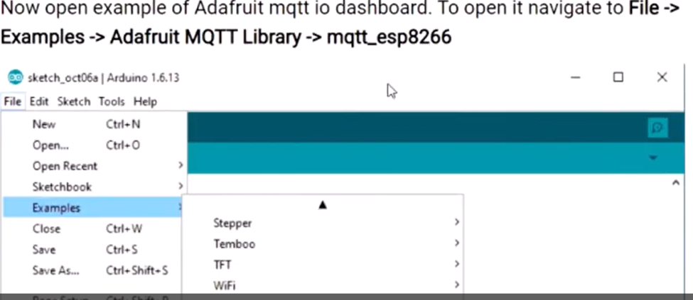
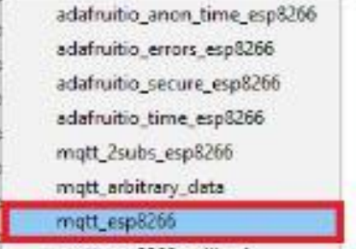

Slide 33
Here we are using the Adafruit server for MQTT Client demo purpose.
In the IOT platform, Adafruit IO Dashboard allows us to visualize and provides control over the connected devices to the internet.
Anyone can visualize and analyze live data from their sensor devices. To learn more and start with Adafruit IO Dashboard refer link :
Creating a Dashboard | Adafruit IO Basics: Dashboards | Adafruit Learning System

Slide 34
Just sign up and create a dashboard.
After the successful creating of the dashboard, we will get the AIO key which is later used to access feed data.
Once we created a dashboard on Adafruit we can add various blocks that can be used to control devices as well as monitor the status of devices.

Slide 35
Lets go to our task
Publish DHT11 Sensor Data to Adafruit IO Platform Using ESP8266 .
This will shows how to send temperature and humidity data from the DHT11 sensor to Adafruit IO (AIO) platform via the MQTT protocol.
This sensor node acts as an MQTT client and publishes the data.
On the AIO platform the published data will be displayed using graphs.

Slide 36
Components Required
NodeMCU
DTH11 Sensor
Jumper Wires (Male-To-Male)
Breadboard

Slide 37
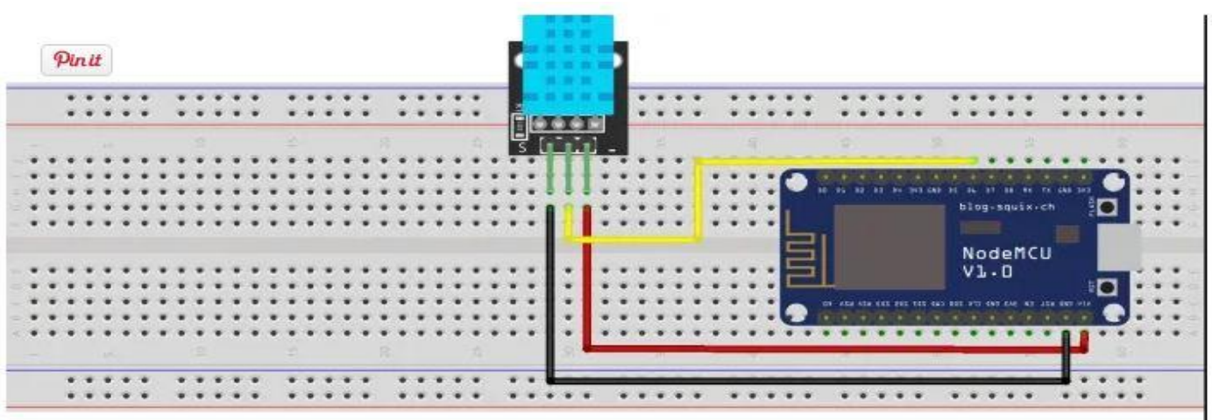
Connect the DATA pin of the DHT11 sensor to the NodeMCU D6 pin and VCC, GND to Vin, and GND pins respectively of NodeMCU.
The circuit diagram is shown below:

Slide 38
This is is for the code:
https://turbofuture.com/computers/Publish-DHT11-Sensor-Data-To-Adafruit-IO-Platform-using-ESP8266

Slide 39
#include <ESP8266WiFi.h>
#include "Adafruit_MQTT.h"
#include "Adafruit_MQTT_Client.h"
#include "DHT.h"
#define WLAN_SSID "YOUR_TECHNOPOP6MADO"
#define WLAN_PASS "YOUR_WIFI_MADO1982"
#define AIO_SERVER "io.adafruit.com"
#define AIO_SERVERPORT 1883 // use 8883 for SSL
#define AIO_USERNAME "YOUR_YANKURIJE"
#define AIO_KEY "aio_JBGb38qtGt9gV0E8tuDqk6Ou5sdk"
#define DHTPIN D6
#define DHTTYPE DHT11
DHT dht(DHTPIN, DHTTYPE);
WiFiClient client;
Adafruit_MQTT_Client mqtt(&client, AIO_SERVER, AIO_SERVERPORT, AIO_USERNAME, AIO_KEY);
Adafruit_MQTT_Publish temperature = Adafruit_MQTT_Publish(&mqtt, AIO_USERNAME "/feeds/temp");
Adafruit_MQTT_Publish humidity = Adafruit_MQTT_Publish(&mqtt, AIO_USERNAME "/feeds/hum");
void MQTT_connect();

Slide 40
void setup() {
Serial.begin(115200);
dht.begin();
delay(10);
Serial.println(F("Adafruit MQTT demo"));
// Connect to WiFi access point.
Serial.println(); Serial.println();
Serial.print("Connecting to ");
Serial.println(WLAN_SSID);
WiFi.begin(WLAN_SSID, WLAN_PASS);
while (WiFi.status() != WL_CONNECTED) {
delay(500);
Serial.print(".");
}
Serial.println();
Serial.println("WiFi connected");
Serial.println("IP address: "); Serial.println(WiFi.localIP());
}

Slide 41
uint32_t x=0;
void loop() {
// Ensure the connection to the MQTT server is alive (this will make the first
// connection and automatically reconnect when disconnected). See the MQTT_connect
// function definition further below.
MQTT_connect();
// Read humidity
float h = dht.readHumidity();
// Read temperature as Celsius
float t = dht.readTemperature();
//publish temperature and humidity
Serial.print(F("\nTemperature: "));
Serial.print(t);
Serial.print(F("\nHumidity: "));
Serial.print(h);
temperature.publish(t);
humidity.publish(h);
delay(60000);
}

Slide 42
// Function to connect and reconnect as necessary to the MQTT server.
// Should be called in the loop function and it will take care if connecting.
void MQTT_connect() {
int8_t ret;
// Stop if already connected.
if (mqtt.connected()) {
return;
}

Slide 43
Serial.print("Connecting to MQTT... ");
uint8_t retries = 3;
while ((ret = mqtt.connect()) != 0) { // connect will return 0 for connected
Serial.println(mqtt.connectErrorString(ret));
Serial.println("Retrying MQTT connection in 5 seconds...");
mqtt.disconnect();
delay(5000); // wait 5 seconds
retries--;
if (retries == 0) {
// basically die and wait for WDT to reset me
while (1);
}
}
Serial.println("MQTT Connected!");
}

Slide 44
END OF THIS MODULE
THANKS.

